Slide 1
ADAS
Document ID | 1
Owner | Phan Văn Nguyên
Version | 1.0
Issued Date | 22-Aug-2023
Status | Approved
Confidential Level | Internal

Slide 2
Agenda
What is ADAS ?
The development history of ADAS System.
Why is ADAS technology important?
Learn about the working principle of ADAS technology.
Features and applications of ADAS safe driving assistance system.

Slide 3
1. What is ADAS?
ADAS technology stands for Advanced Driver Assistance Systems, which means advanced driver assistance systems.
Active and passive safety systems designed to eliminate the element of human error when operating a variety of vehicles.
Advanced Driving Assistance Systems with proven ADAS technology help reduce accident rates while in traffic by limiting the possibility of driver error through intelligent warning functions, such as:
According to research by the American Association of Highway Safety:
Forward collision warning: reduce the number of rear-end car accidents by 27%
Lane departure warning: reduce the number of fatal accidents by 21%
blind spot detection: 14% reduction in lane collision accidents
drowsy driver detection
downhill control
night vision system and parking assist system

Slide 4
2. The development history of ADAS System.
In the late 1970s, a series of safety assistance technologies appeared on American cars, such as the electronic anti-lock braking system (ABS).This is considered one of the outstanding safety features of ADAS.
In the 2000s, the ADAS technology system began to "pop up" in the United States with a number of safety warning features such as night vision control, dynamic laser cruise control, lane departure warning, assist lane keeping assist…
In 2014, the U.S. Department of Transportation announced that all new vehicles under 10,000 pounds (4,500 kg) must be equipped with rear-view cameras.In addition, manufacturing enterprises have also researched and developed a number of other technologies to enhance vehicle safety.From here, ADAS safe driving aids "emerged" as a trend and received a positive response from consumers.

Slide 5
3. Why is ADAS technology important?
The analysis shows that around 94% of accidents are caused by humans, with the rest due to environmental factors and technical errors.
As mentioned above, statistics show that most of the causes of accidents are related to people, possibly due to falling asleep, not paying attention when driving or mishandling situations when participating in traffic. .
That is why ADAS technology is so important to assist and help drivers detect and reduce unnecessary accidents. ADAS features such as automatic emergency braking, pedestrian detection, surround view, parking assist, drowsiness warning and eye detection, play an important role in reducing car accidents. and save lives.

Slide 6
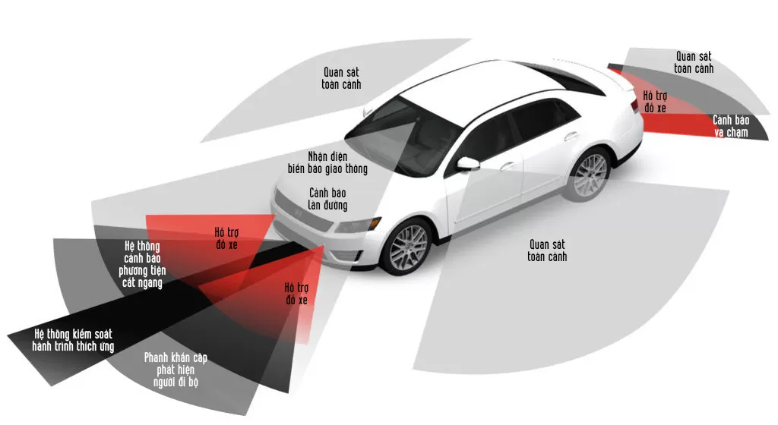
4. Learn about the working principle of ADAS technology.

Slide 7
4. Learn about the working principle of ADAS technology.
ADAS works by warning the driver of danger or taking action to avoid an accident.
ADAS-equipped vehicles have a range of sensors to enhance vision, hearing and decision-making, for example when driving in the dark:
RADAR can help determine the distance from the vehicle to surrounding objects.
The SONAR sensor can help determine the position of moving objects around the vehicle.
LiDAR cameras and sensors are also used to assist in seeing in all directions at once.

Slide 8
5. Features and applications of ADAS safe driving assistance system.
Adaptive Cruise Control
Adaptive Light Control
Night vision
Automatic parking

Slide 9
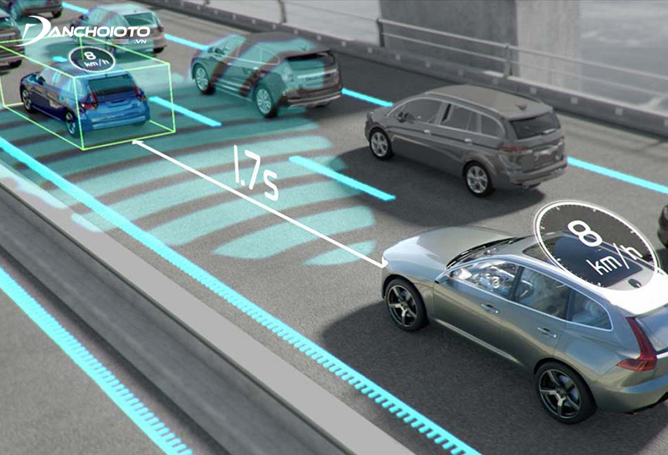
5.1. Adaptive Cruise Control

Slide 10

5.2. Adaptive Light Control

Slide 11

5.3. Night vision

Slide 12
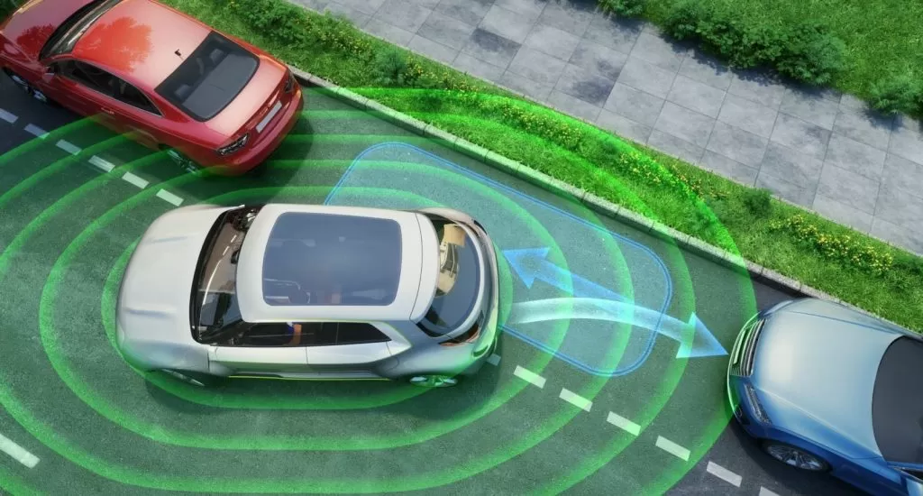
5.4. Automatic parking

Slide 13

5.5. Drowsy detection

Slide 14
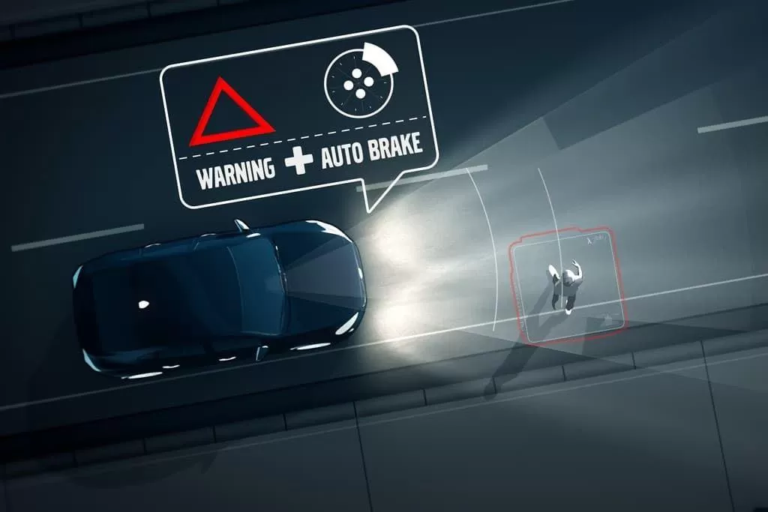
5.6. Automatic emergency brake

